Slide 1
WEEK 7 · LECTURE 13
Building a Support Copilot
Part 1: the layer that reads
5,000 tickets a week, three agents, and nothing in the queue has ever been sorted. Let's ship anyway.
ISBA 2411 · Natural Language Processing & AI · Summer 2026

Slide 2
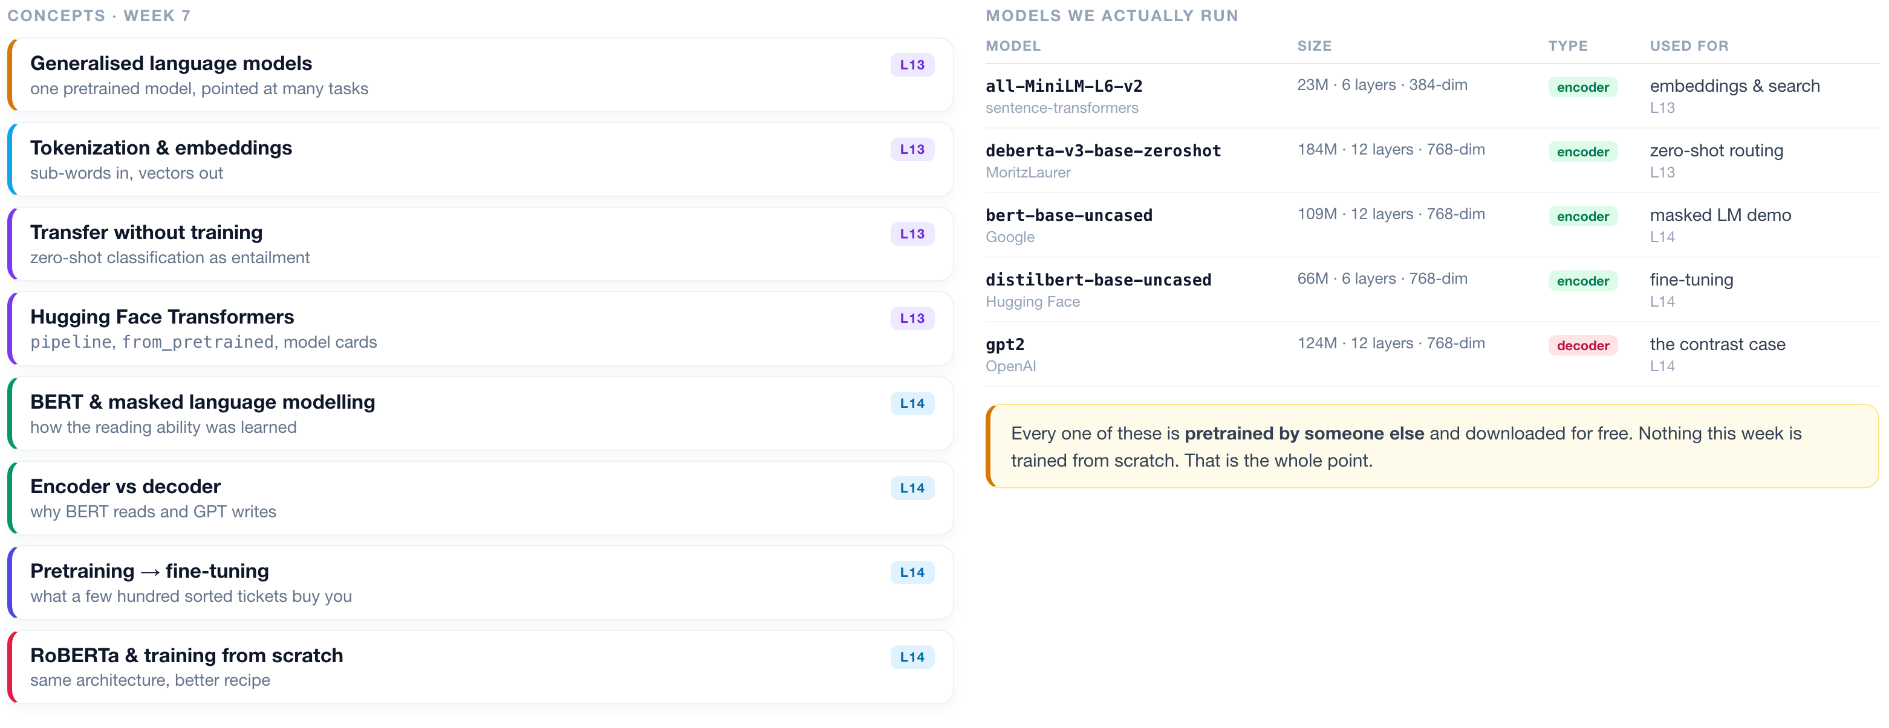
WEEK 7 · AT A GLANCE
Language Models & Transformers
What we cover across both lectures, the models we actually run, and what to read alongside them.
READINGS
J&M Ch. 7 Large Language Models
J&M Ch. 10 BERT & masked LMs
HOLLM Ch. 3 inside transformer LLMs
Tunstall Ch. 10 training from scratch
Vaswani 2017 Attention Is All You Need
Devlin 2018 BERT
Liu 2019 RoBERTa
ISBA 2411 · Natural Language Processing & AI · Summer 2026

Slide 3
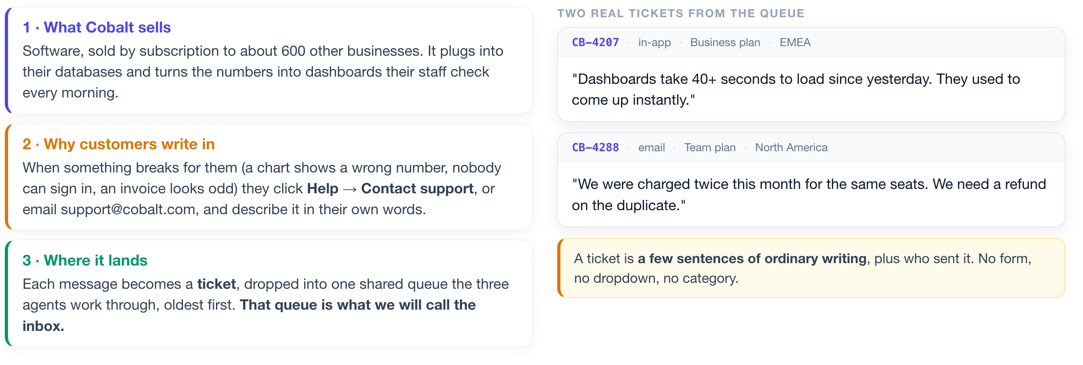
THE BUSINESS
First, what company are we walking into?
Before any technology, you need to be able to picture the job. Here it is in three sentences.
Five thousand of these arrive every week. Three people answer them.
ISBA 2411 · Natural Language Processing & AI · Summer 2026

Slide 4
THE PROBLEM
Every ticket has to be read before it can be answered.
And that reading is where the three agents lose their day.
~5,000 tickets a week
~40% are repeats
Nothing is sorted
Minutes lost per ticket
and three people to answer them
the same handful of questions
no tags, no categories, just text
just working out who should own it
WHY THAT THIRD BOX IS THE HARD ONE
The normal way to teach a computer to sort text is to hand it a few thousand examples that a person has already sorted by hand. Those hand-sorted examples are called training data, and most machine learning cannot start without them. Cobalt has none. Building that pile would mean paying people to read and tag thousands of tickets before you could write a line of code.
So tonight we build something that never needs them. We start with the half that READS the inbox: search it, sort it, and decide what a person actually has to see.
ISBA 2411 · Natural Language Processing & AI · Summer 2026

Slide 5
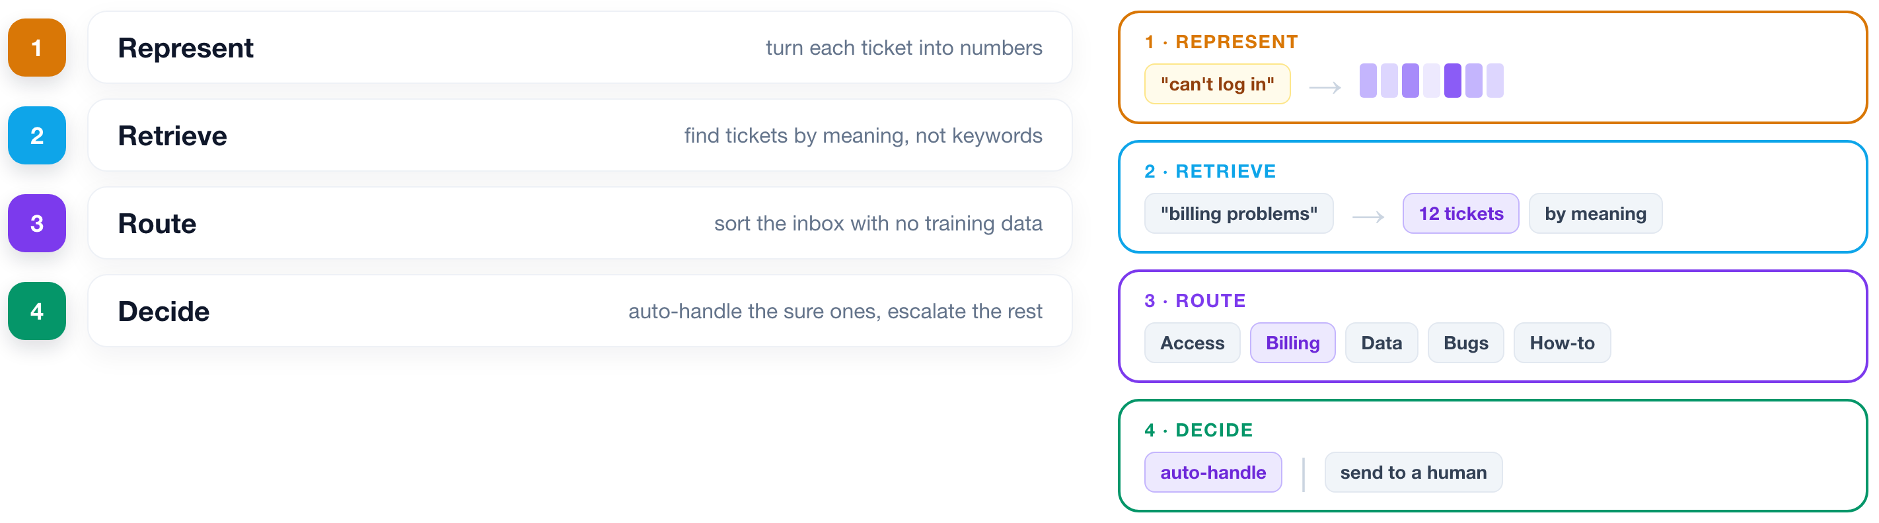
THE PLAN
Four capabilities, built in order.
Each one is useful on its own. Together they are a product.
ISBA 2411 · Natural Language Processing & AI · Summer 2026

Slide 6
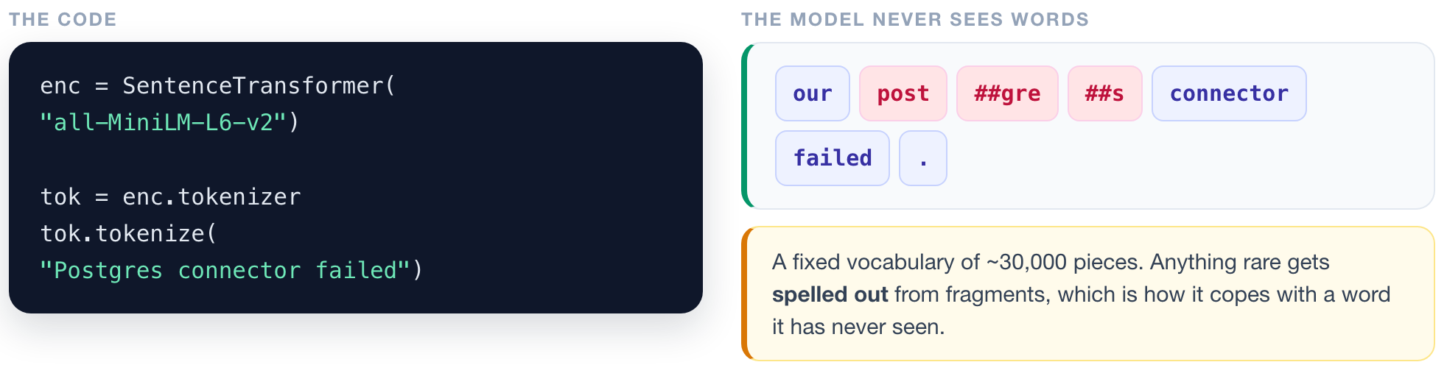
REPRESENT
1
2
3
4
A model cannot read. It can only do arithmetic.
▶ NOTEBOOK
STEP 6
Split text into tokens
ISBA 2411 · Natural Language Processing & AI · Summer 2026

Slide 7
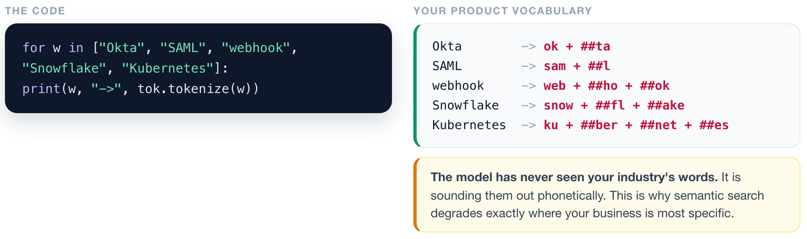
REPRESENT
1
2
3
4
Check what happens to your business vocabulary.
▶ NOTEBOOK
STEP 7
Test your product vocabulary
ISBA 2411 · Natural Language Processing & AI · Summer 2026

Slide 8
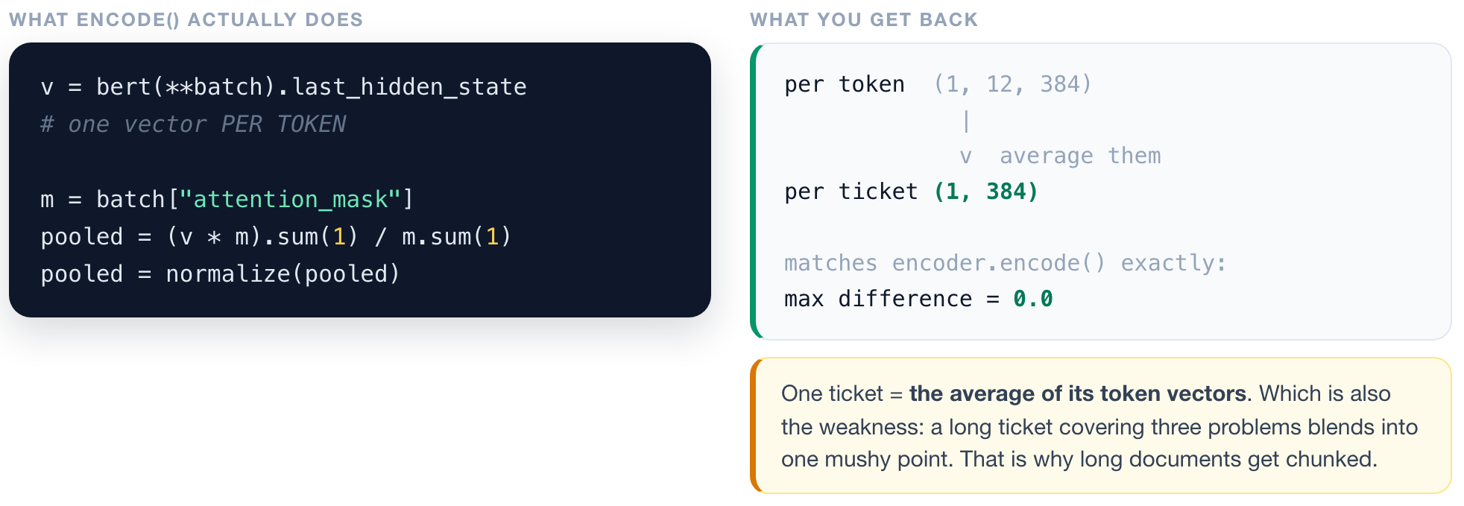
REPRESENT
1
2
3
4
One ticket becomes one vector, by averaging.
▶ NOTEBOOK
STEP 8
Pool tokens into one vector
ISBA 2411 · Natural Language Processing & AI · Summer 2026

Slide 9
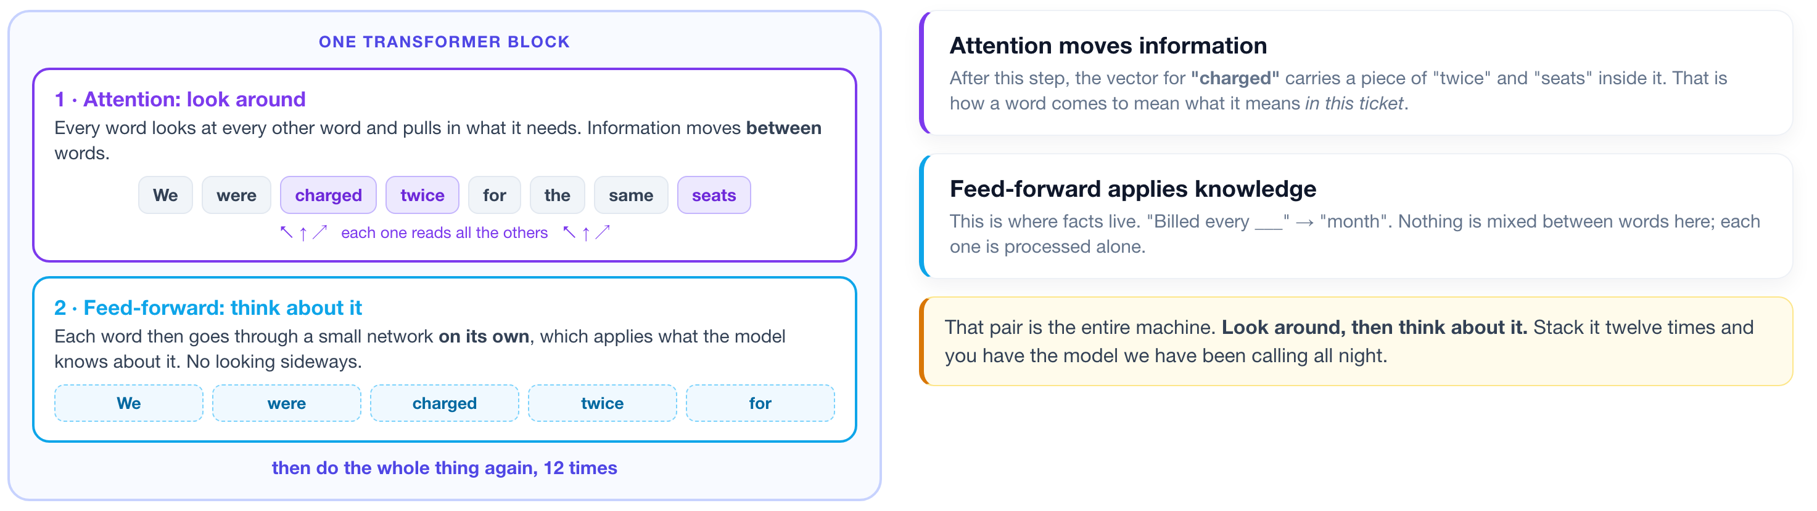
INSIDE THAT ONE LINE
1
2
3
4
What actually happened inside bert(...)?
You just called a transformer and got vectors back. Ninety seconds on what it did with them.
▶ NOTEBOOK
STEP 9
Watch attention change a word
ISBA 2411 · Natural Language Processing & AI · Summer 2026

Slide 10
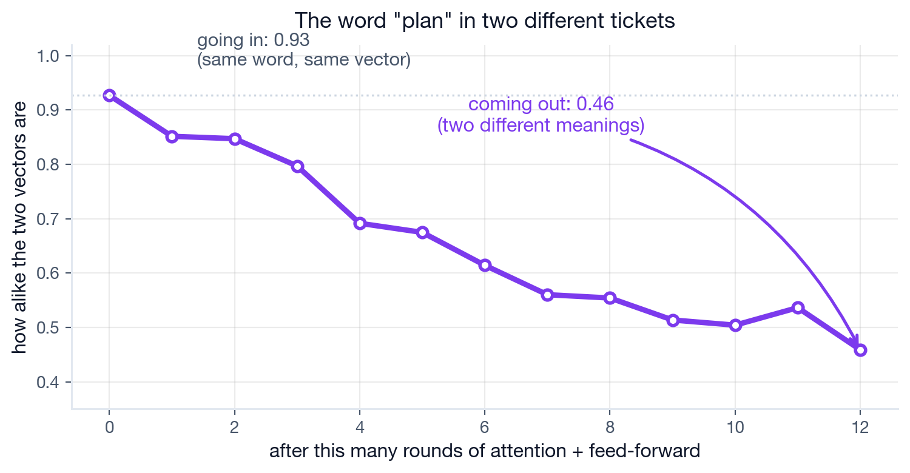
THE ATTENTION HALF
1
2
3
4
A word absorbs the words around it.
"Plan" is a subscription tier in one ticket and an intention in another. Same word, same starting vector.
Going in they are 0.93 alike. Twelve rounds later, 0.46. That gap is attention doing its job.
▶ NOTEBOOK
STEP 9
Watch attention change a word
ISBA 2411 · Natural Language Processing & AI · Summer 2026

Slide 11
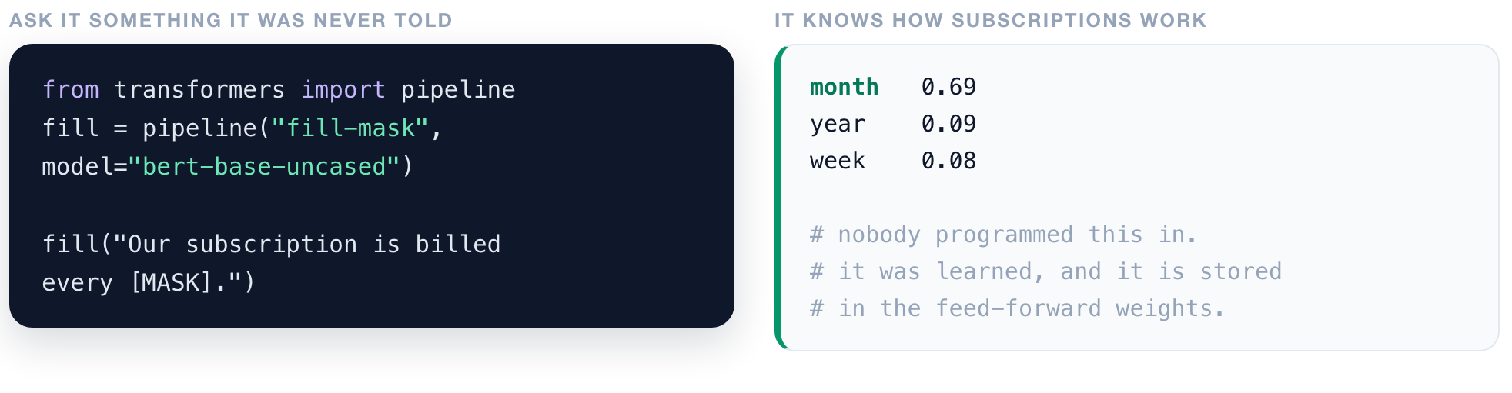
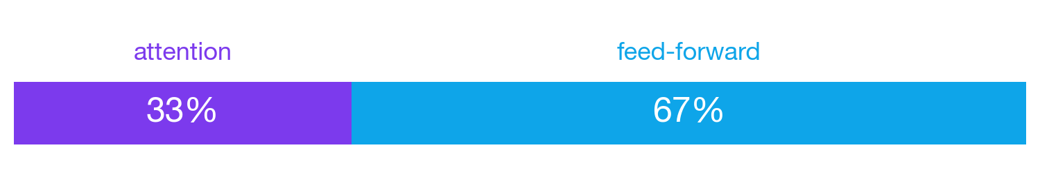
THE FEED-FORWARD HALF
1
2
3
4
Where the model keeps what it knows.
Two thirds of every layer is feed-forward, only a third is attention. Attention gets the headlines; the knowledge lives next door.
▶ NOTEBOOK
STEP 10
Find where the knowledge is stored
ISBA 2411 · Natural Language Processing & AI · Summer 2026

Slide 12
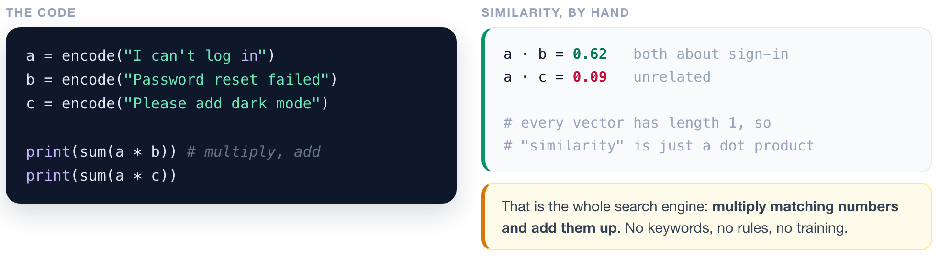
RETRIEVE
1
2
3
4
Similarity is a multiplication.
▶ NOTEBOOK
STEP 11
Measure similarity by hand
ISBA 2411 · Natural Language Processing & AI · Summer 2026

Slide 13
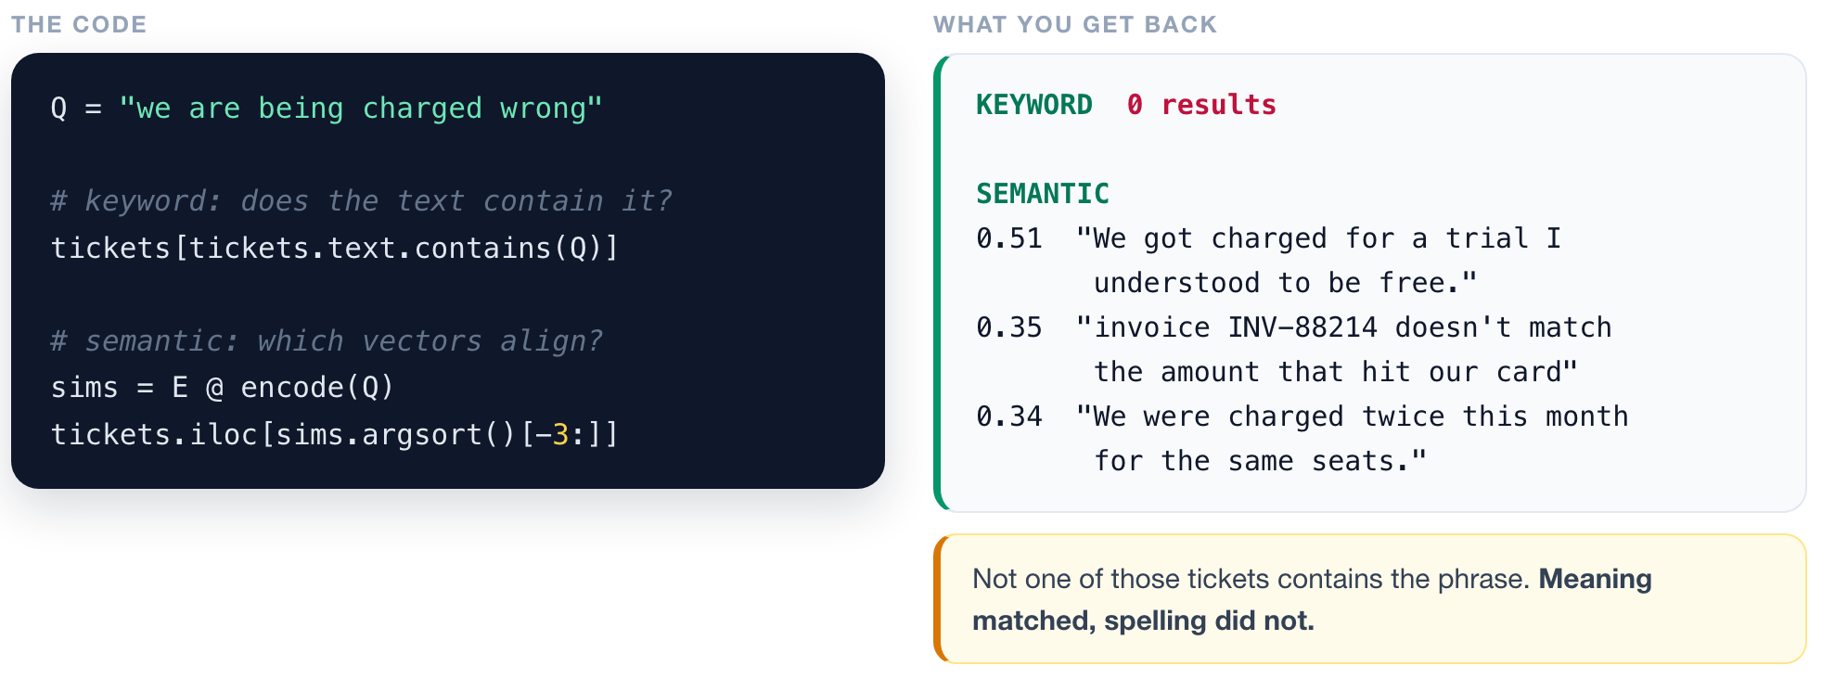
RETRIEVE
1
2
3
4
Search that finds what you meant.
▶ NOTEBOOK
STEP 3
Turn tickets into vectors, then search
ISBA 2411 · Natural Language Processing & AI · Summer 2026

Slide 14
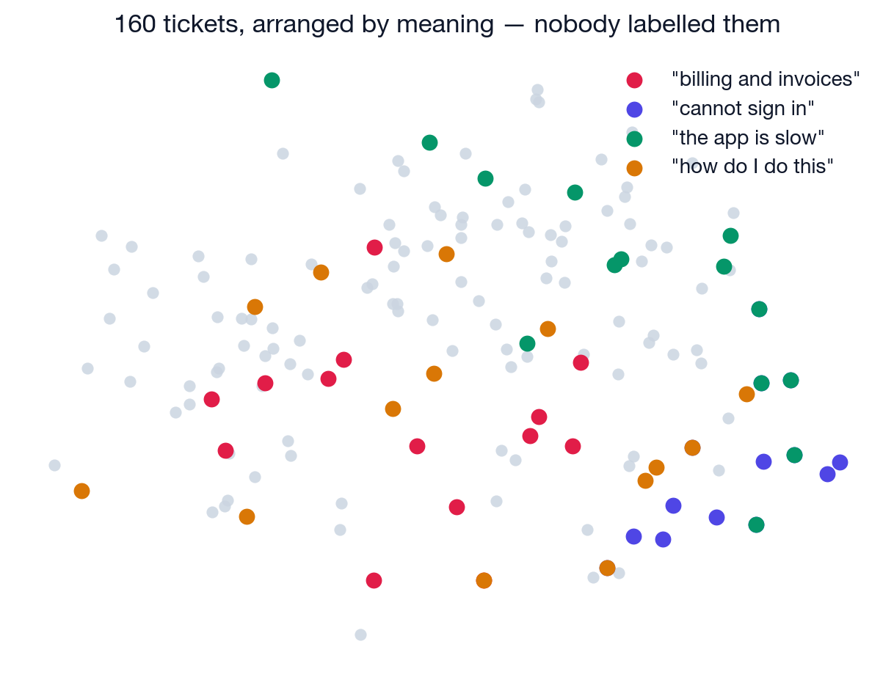
RETRIEVE
1
2
3
4
Structure was already in the text.
Nobody sorted these. Plot the vectors and the neighbourhoods appear on their own.
▶ NOTEBOOK
STEP 5
Map the whole inbox
ISBA 2411 · Natural Language Processing & AI · Summer 2026

Slide 15
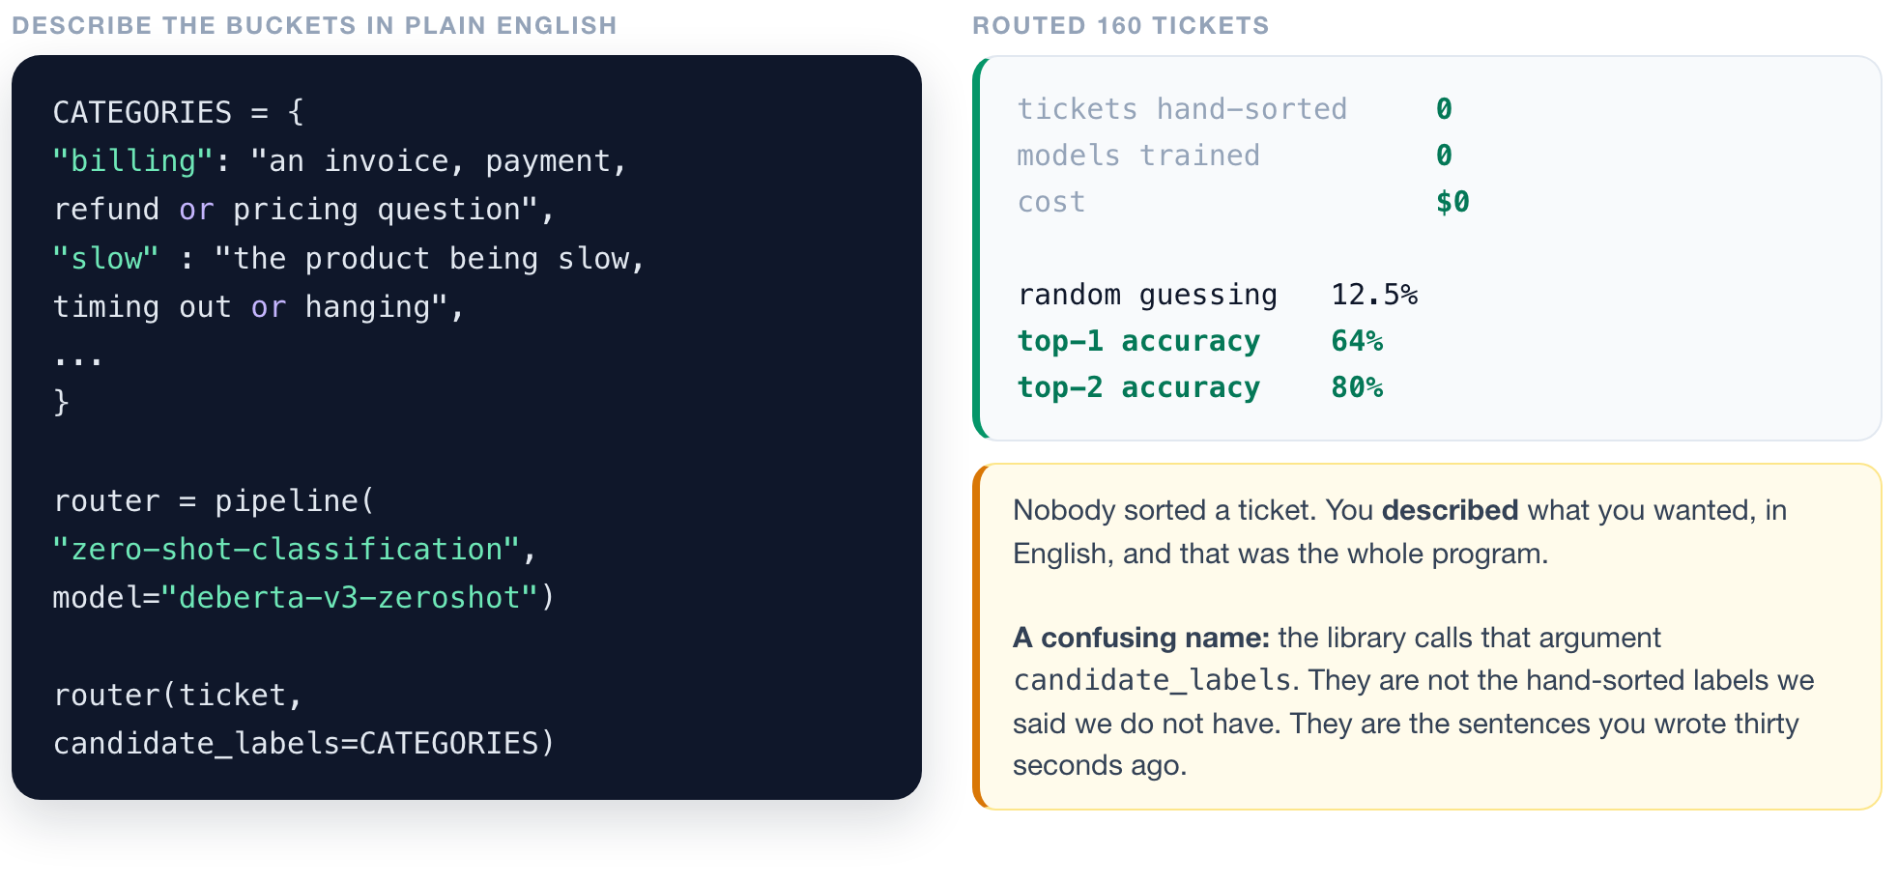
ROUTE
1
2
3
4
Sort the inbox with no training data at all.
▶ NOTEBOOK
STEP 13
Route the inbox with no training data
ISBA 2411 · Natural Language Processing & AI · Summer 2026

Slide 16
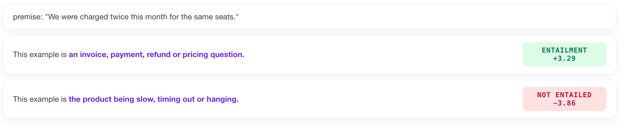
ROUTE
1
2
3
4
It is not a classifier. It is a fact-checker.
The model judges whether a sentence YOU wrote is true of the ticket.
Every category becomes a sentence: "This example is {your description}." The model scores all eight and picks whichever it most believes.
▶ NOTEBOOK
STEP 17
See the entailment scores
ISBA 2411 · Natural Language Processing & AI · Summer 2026

Slide 17
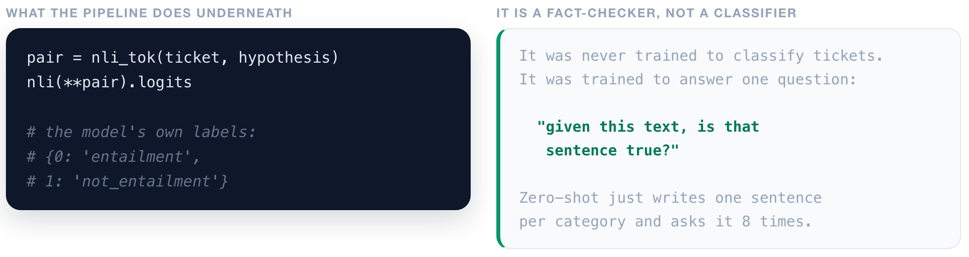
ROUTE
1
2
3
4
Underneath the one-line pipeline.
▶ NOTEBOOK
STEP 17
See the entailment scores
ISBA 2411 · Natural Language Processing & AI · Summer 2026

Slide 18
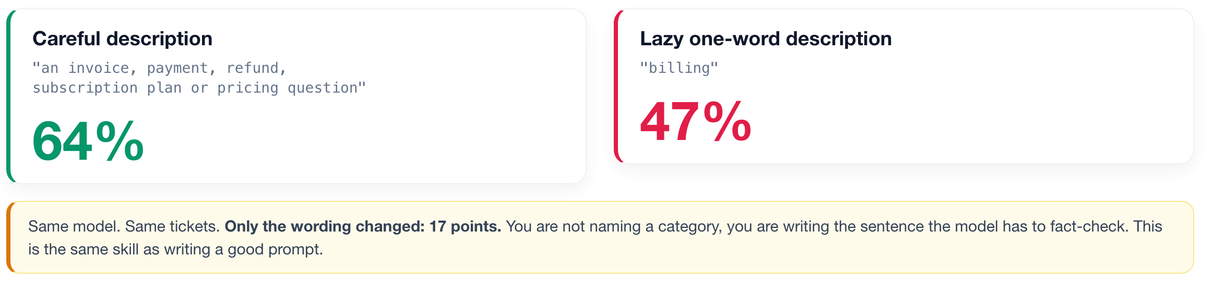
ROUTE
1
2
3
4
The descriptions you write ARE the program.
▶ NOTEBOOK
STEP 16
YOUR KNOB: rewrite the descriptions
ISBA 2411 · Natural Language Processing & AI · Summer 2026

Slide 19
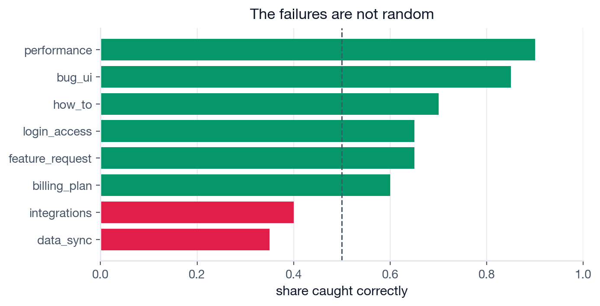
DECIDE
1
2
3
4
An average is a bad way to run a product.
Ask WHICH tickets it gets wrong. The weak buckets are the ones whose descriptions overlap.
When a classifier underperforms, look at your taxonomy before you look at your model.
▶ NOTEBOOK
STEP 18
Find the weak buckets
ISBA 2411 · Natural Language Processing & AI · Summer 2026

Slide 20
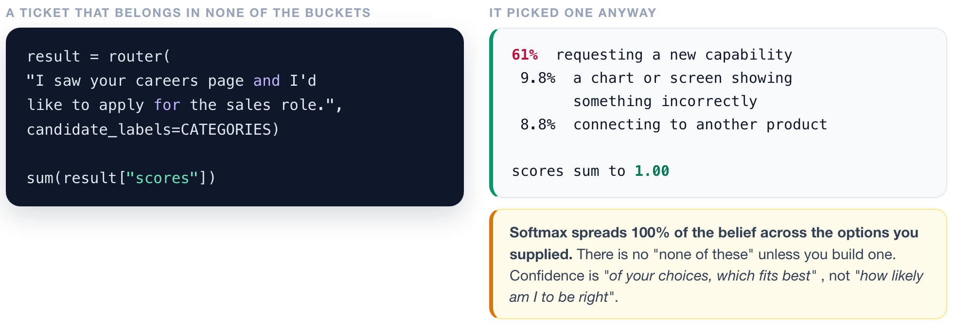
DECIDE
1
2
3
4
Confident is not the same as correct.
▶ NOTEBOOK
STEP 19
Feed it an off-topic ticket
ISBA 2411 · Natural Language Processing & AI · Summer 2026

Slide 21
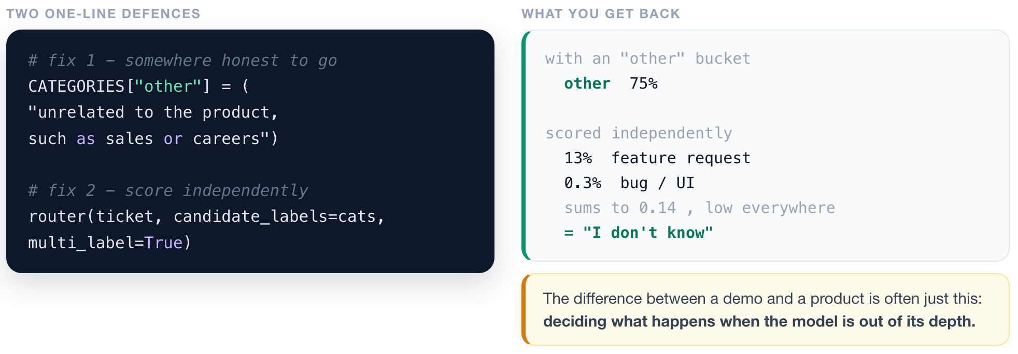
DECIDE
1
2
3
4
Give the model a way to say "I don't know".
▶ NOTEBOOK
STEP 20
Add the two defences
ISBA 2411 · Natural Language Processing & AI · Summer 2026

Slide 22
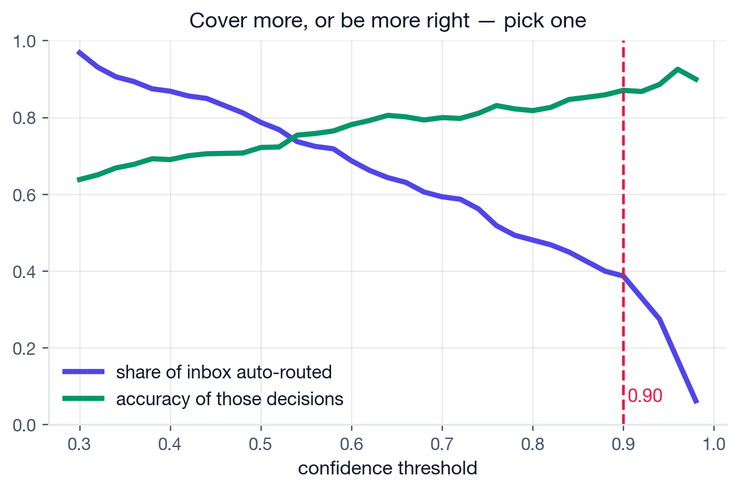
DECIDE
1
2
3
4
This curve is the business decision.
There is no setting that maximises both. Where you stand on it is a judgement about cost.
SET IT AT 0.90 AND SHIP
39%
of the inbox handled automatically
87%
accurate on those decisions
~1,937
tickets a week nobody has to touch
"We can automate 39% of the inbox at 87% accuracy, or cover far more and be less right." That is a decision an executive can actually make.
▶ NOTEBOOK
STEP 21
YOUR KNOB: set the threshold
ISBA 2411 · Natural Language Processing & AI · Summer 2026

Slide 23
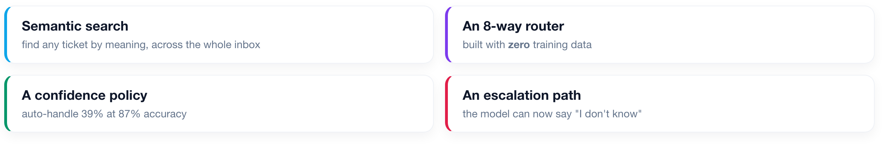
FULL CIRCLE
What we shipped today, for $0.
No training data. No training run. No GPU bill. One afternoon.
Someone else already spent millions teaching a model to read English. Your job is not to build intelligence. It is to point it at your problem, cheaply, and know where it breaks.
ISBA 2411 · Natural Language Processing & AI · Summer 2026

Slide 24
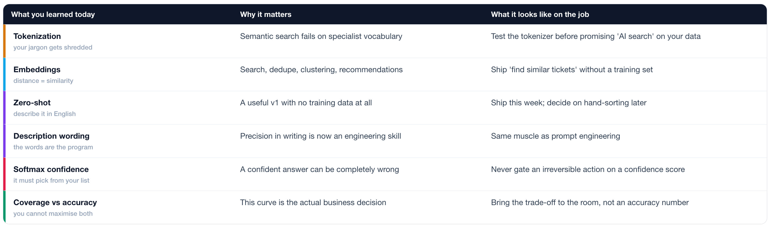
WHY THIS MATTERS AT WORK
Six instincts, not six tools.
Every row is a call your future team needs someone in the room able to make.
ISBA 2411 · Natural Language Processing & AI · Summer 2026

Slide 25
NEXT TIME
The layer that acts.
What if we DO sort them by hand?
a few hundred examples, and what they buy you
Where the reading came from
BERT, and how pretraining actually worked
Pull out the specifics
which feature, what error, which plan
Watch it make things up
and why that sets up Week 8
Notebook: L13_Cobalt_Support_Copilot.ipynb. Run it, turn the knobs, break it.
ISBA 2411 · Natural Language Processing & AI · Summer 2026

